Slide 1
Data Wrangling Master Tutorial
Using R, R Studio, and Python
Gina Bufton, Georgia Institute of Technology
Rob Stilson, Lockheed Martin

Slide 2
Overview
Introduction
What is Data Wrangling?
Tools for this tutorial
Live demonstration
How to choose?
Questions

Slide 3
Introduction
Who we are

Slide 4

What is Data Wrangling?
Data Acquisition
Joining Data
Data Cleansing (Main area of focus for tutorial)
Import messy data
Clean it
String
Regex
Numeric
Melt
Split
Create
Recode
Summarize
Visualize it

Slide 5


Tools for This Tutorial
R (GUI, Jupyter and Rstudio)
Libraries
Reshape2
Dplyr
Ggplot2
Python (GUI, Jupyter)
Packages
Pandas
Numpy
MatPlotLib
Seaborn

Slide 6

Live Demonstration
To the code!
If we have internet access go here
https://github.com/RobStilson/SIOP_2018_Master_Tutorial

Slide 7
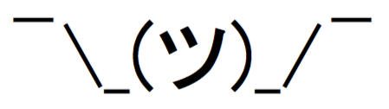
How to Choose?
Stats background?
R
Programming background?
Python
Where will this live?
Locally-R
On a server-Python
Don’t choose
Learn both (preferably not at the same time if just starting out)

Slide 8

Immediate Next Steps
Coursera Courses
Johns Hopkins
Duke
Udemy Courses
Jose Portilla
Kirill Eremenko
Notes:
From: https://www.datasciencecentral.com/profiles/blogs/difference-between-machine-learning-data-science-ai-deep-learning

Slide 9
Questions?

Slide 10
Appendix

Slide 11
Things I may not have mentioned due to time constraints
R Studio recorded webinars
Analytics Vidhya
Kaggle Datasets
Meetup groups for R, Python, etc.
Notes:
From: https://www.datasciencecentral.com/profiles/blogs/difference-between-machine-learning-data-science-ai-deep-learning

Slide 12

Collision of Data Science and I-O
This is happening!
I-O
Theory
Frequentist Statistics Approach
Data Science
Empiricism
Machine Learning
Bayesian Statistics Approach
Data Integration
Distributed Architecture
Dashboards and BI
Automated data-driven decisions
Notes:
From: https://www.datasciencecentral.com/profiles/blogs/difference-between-machine-learning-data-science-ai-deep-learning

Slide 13

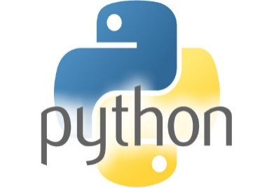
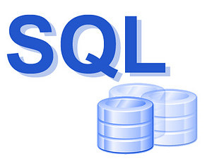

The Big 4
The following are the current gate keepers of the job market
R
Python (Anaconda)
SQL
Tableau
Why learn them?
Where to learn them?
Coursera
Udemy
Class Central

Slide 14
How the Big 4 will help you
Data Wrangling
Data Cleaning
Text Cleaning
Data Visualization
Easier to pick up issues with the data (Anscombe’s Quartet)
Easier to tell stories with the data
Data Modeling
Cross Validation
Reporting
Scalability

